Slide 1

CRM DATA ANALYSIS
Mr. Amar Sadaphal
Mrs. Heena Sharma
Ms. Boyi Vasanthi
Ambika Kumari
Mr. SASIDHARAN.S
Mr. Bharat Nagar

Slide 2
INTRODUCTION
Customer relationship management (CRM) is the combination of practices, strategies and technologies that companies use to manage and analyze customer interactions and data throughout the customer lifecycle. The goal is to improve customer service relationships and assist in customer retention and drive sales growth.
CRM systems compile customer data across different channels, or points of contact, between the customer and the company, which could include the company's website, telephone, live chat, direct mail, marketing materials and social networks. CRM systems can also give customer-facing staff members detailed information on customers' personal information, purchase history, buying preferences and concerns.

Slide 3
COMPONENTS OF CRM
Marketing automation.
Sales force automation.
Geolocation technology, or location-based services.
Workflow automation.
Lead management.
Human resource management (HRM).
Analytics.
Artificial intelligence.

Slide 4
BENEFIT OF CRM
Trustworthy reporting
Dashboards that visually showcase data
Improved messaging with automation
Simplified collaboration
Efficiency enhanced by automation

Slide 5
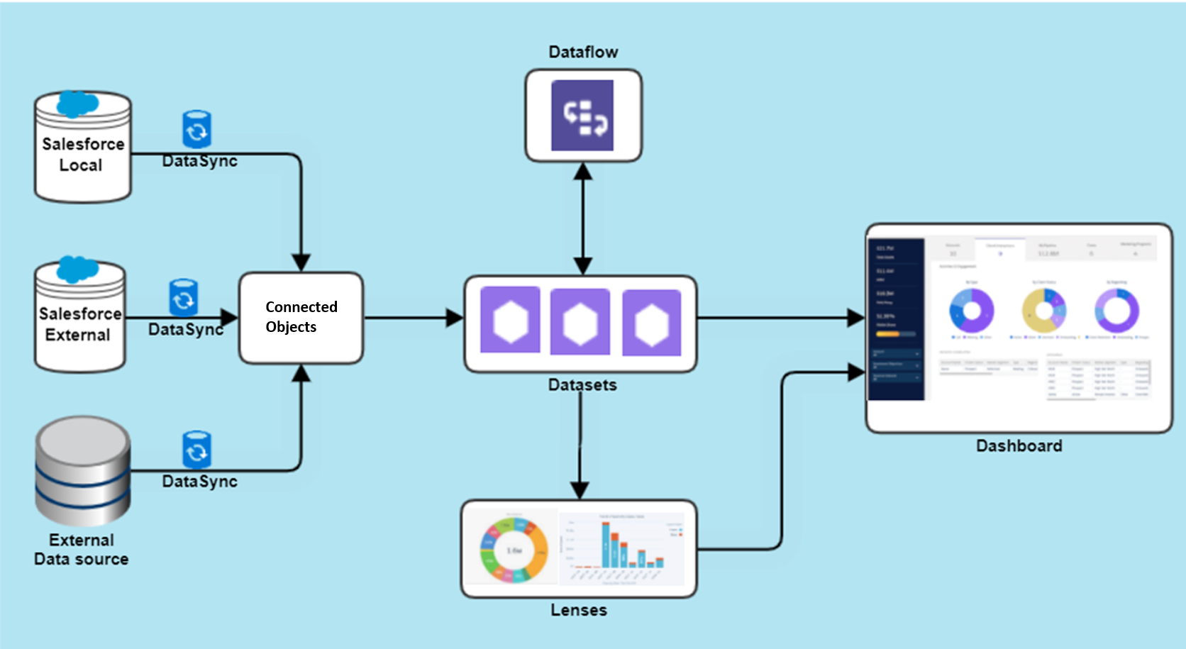
DATA MODEL

Slide 6
VISUALIZATION TOOL WHICH WE USE!
Line chart
Column chart
pie chart
Gauge chart
Doughnut charts
Clustered bar chart

Slide 7
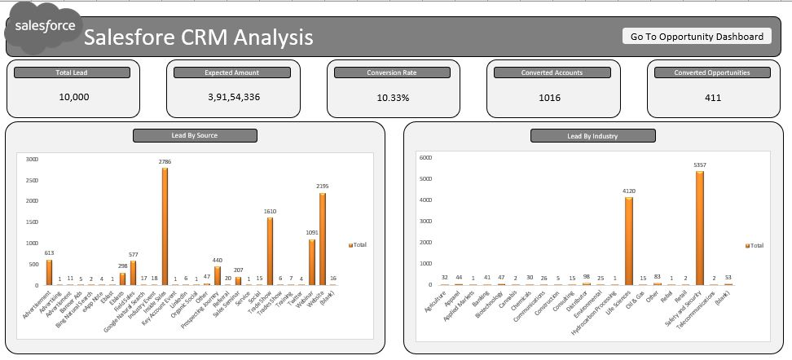
EXCEL DASHBOARD
LEADS

Slide 8
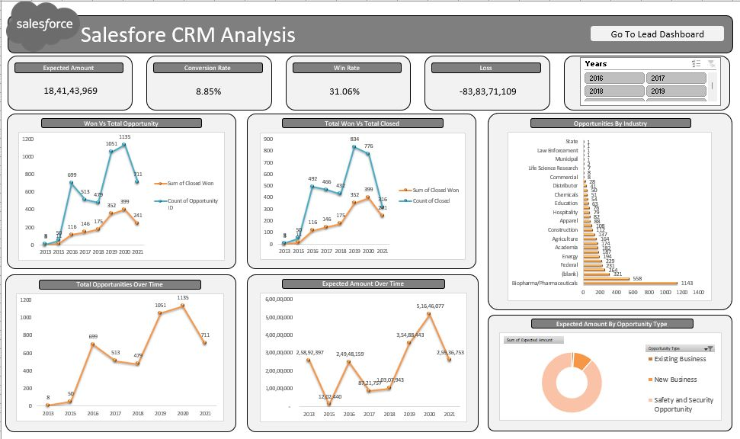
EXCEL DASHBOARD
OPPORTUNITY

Slide 9
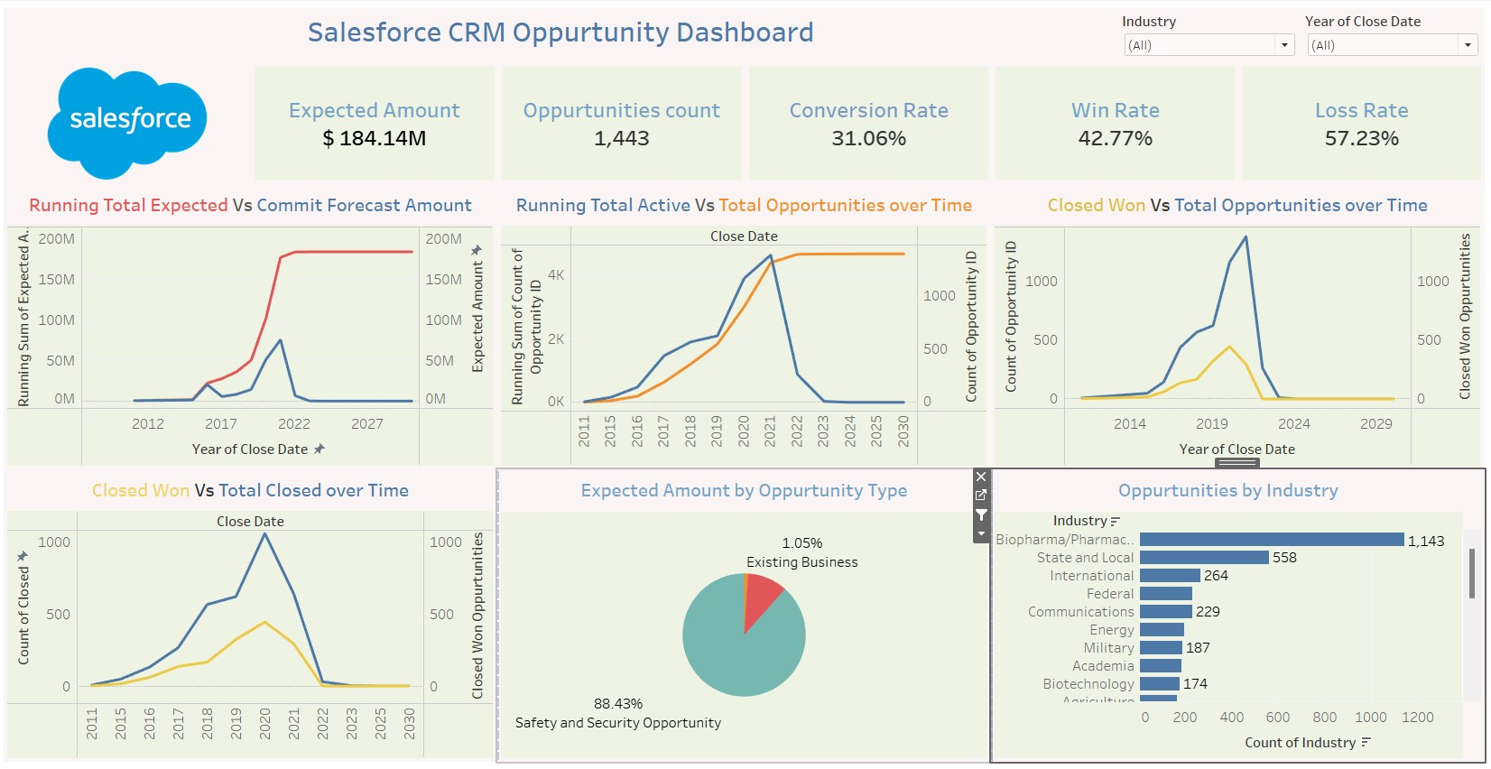
TABLEAU DASHBOARD
OPPORTUNITY

Slide 10
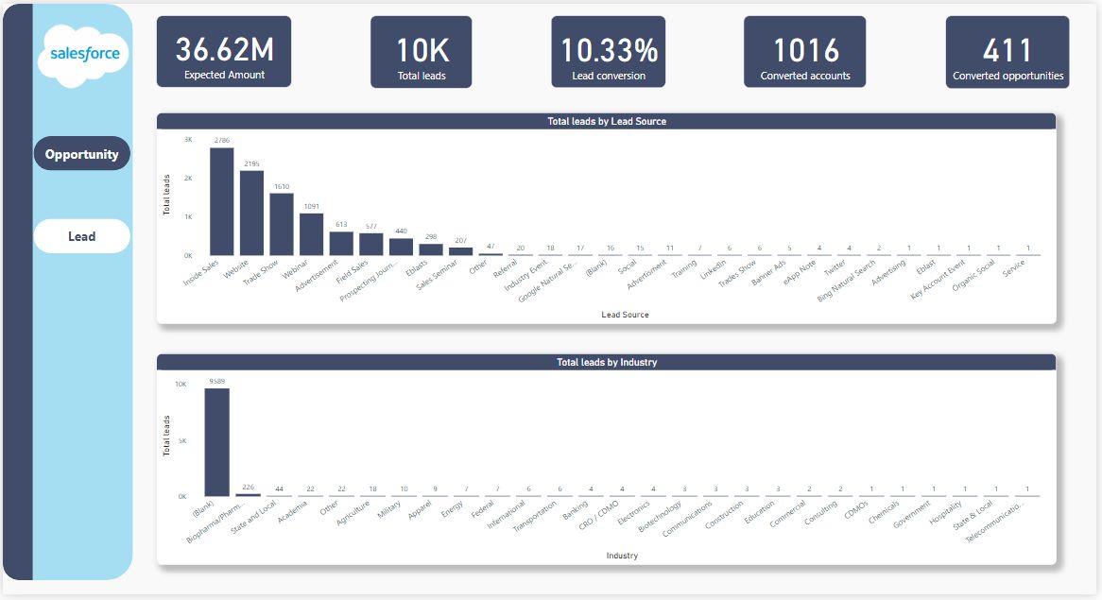
POWER-BI DASHBOARD
LEADS

Slide 11
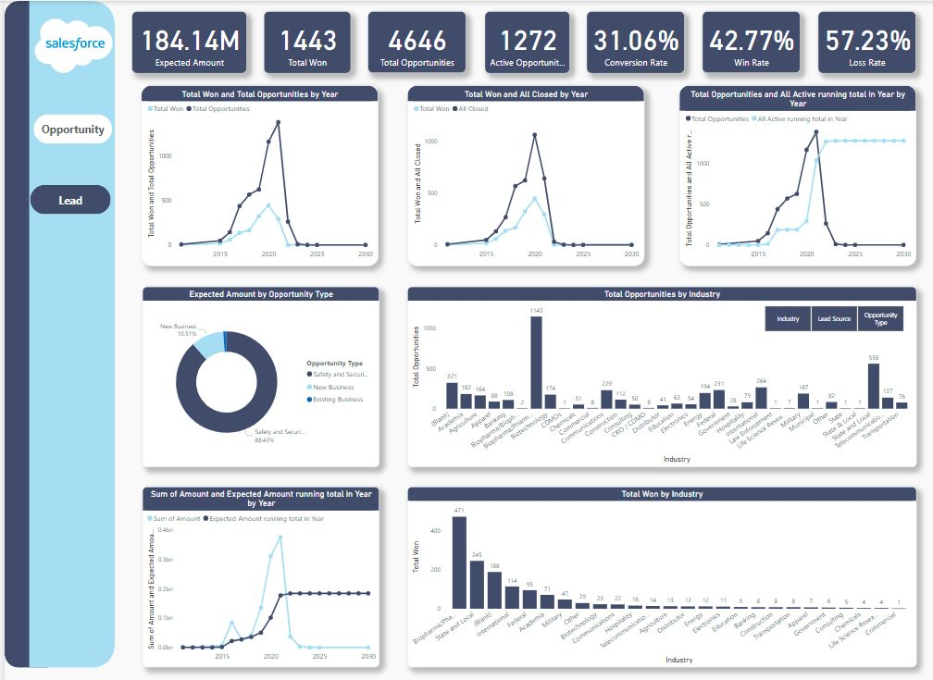
POWER-BI DASHBOARD
OPPORTUNITY

Slide 12


